Slide 1
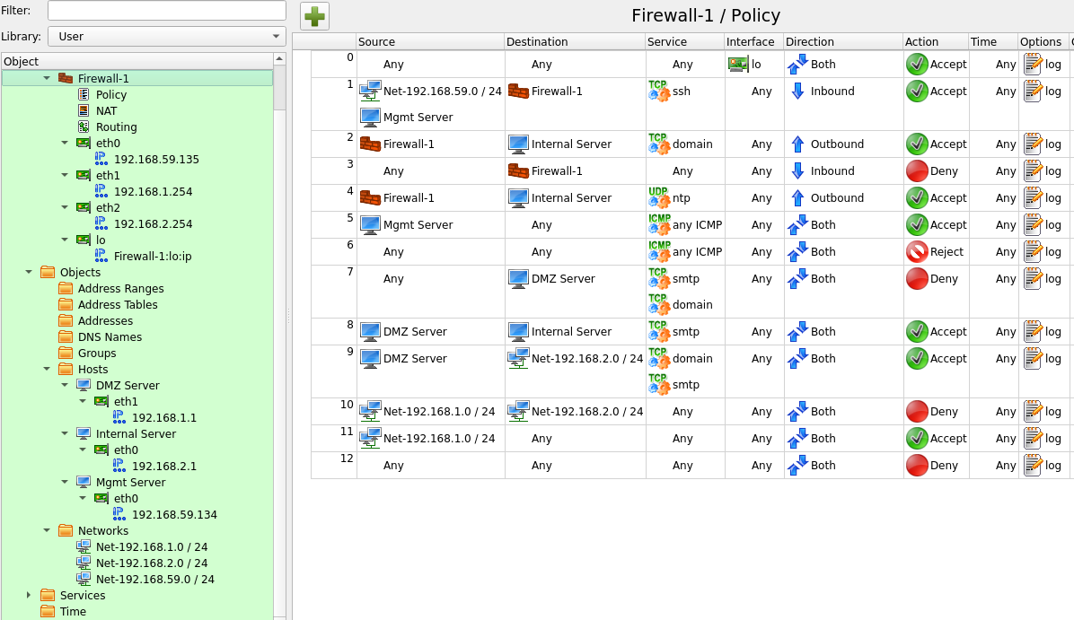

Slide 2



192.168.59.0 / 24
Mgmt Server
192.168.59.134
eth0
192.168.59.135
eth1
192.168.1.254
eth2
192.168.2.254
Internal Server
192.168.1.1
DMZ Server
192.168.2.1
Firewall-1
192.168.1.0 / 24
192.168.2.0 / 24

Slide 3
Section 1

Slide 4
1) Based on the Firewall-1 Policy, which rule number is effective in blocking SMTP packets with a source IP of 192.168.1.10 to the Internal Server? Effective refers to the first rule in the firewall that match the criteria above. If "Rule 0" is the first rule that will block the packets, enter "0" in the textbox. If none, enter "NONE" in the textbox.
Ans: ____________None (wrong, 10)
2) Based on the Firewall-1 Policy, which rule number is effective in blocking ICMP packets from any IP addresses to Firewall-1?
Effective refers to the first rule in the firewall that match the criteria above.
If "Rule 0" is the first rule that will block the packets, enter "0" in the textbox. If none, enter "NONE" in the textbox.
Ans: ____________3 (correct)

Slide 5
3) Based on the Firewall-1 Policy, which rule number is effective in allowing DNS packets from DMZ Server to Internal Server?
Effective refers to the first rule in the firewall that match the criteria above.
If "Rule 0" is the first rule that will block the packets, enter "0" in the textbox. If none, enter "NONE" in the textbox.
Ans: ____________9 (correct)
4) Based on the Firewall-1 Policy, which rule number is effective in blocking SMTP packets from Mgmt Server to Internal Server?
Effective refers to the first rule in the firewall that match the criteria above.
If "Rule 0" is the first rule that will block the packets, enter "0" in the textbox. If none, enter "NONE" in the textbox.
Ans: ____________12 (correct)

Slide 6
5) Based on the Firewall-1 Policy, which rule number is effective in allowing ICMP packets from DMZ Server to Internal Server?
Effective refers to the first rule in the firewall that match the criteria above.
If "Rule 0" is the first rule that will block the packets, enter "0" in the textbox. If none, enter "NONE" in the textbox.
Ans: ____________none (correct)
6) Based on the Firewall-1 Policy, which rule number is effective in allowing SSH packets from DMZ Server to Internal Server?
Effective refers to the first rule in the firewall that match the criteria above.
If "Rule 0" is the first rule that will block the packets, enter "0" in the textbox. If none, enter "NONE" in the textbox.
Ans: ____________none (correct)

Slide 7
7) Based on the Firewall-1 Policy, which rule number is effective in allowing DNS packets from DMZ Server to Mgmt Server?
Effective refers to the first rule in the firewall that match the criteria above.
If "Rule 0" is the first rule that will block the packets, enter "0" in the textbox. If none, enter "NONE" in the textbox.
Ans: ____________7 ( wrong, 11)
8) Based on the Firewall-1 Policy, Alex attempts to ping Firewall-1 from a computer with IP address 192.168.1.11.
Which is the effective rule number responsible for allowing or blocking connection?
Effective refers to the first rule in the firewall that matches and take the neccessary actions.
Ans: ____________3 blockin (correct)

Slide 8
9) Based on the Firewall-1 Policy, Alex attempts to ping Mgmt Server from a computer with IP address 192.168.1.11.
Which is the effective rule number responsible for allowing or blocking connection?
Effective refers to the first rule in the firewall that matches and take the neccessary actions.
Ans: ____________5 (wrong, 6)
10) Based on the Firewall-1 Policy, Alex attempts to connect to Mgmt Server via FTP from a computer with IP address 192.168.1.11.
Which is the effective rule number responsible for allowing or blocking connection?
Effective refers to the first rule in the firewall that matches and take the neccessary actions.
Ans: ____________11 (correct)

Slide 9
11) Based on the Firewall-1 Policy, Alex is unable to ping Firewall-1 from a computer with IP address 192.168.1.11. Alex removes Rule 3 and attempts again from the same computer. However, he is still unable to ping Firewall-1.
Which is the effective rule number responsible for allowing or blocking connection?
Effective refers to the first rule in the firewall that matches and take the neccessary actions.
Ans: ____________6 (correct)

Slide 10
Section 2

Slide 11
The following are the requirements for Firewall-1 Policy. Based on these requirements, asnwer the questions to identify configuration errors.
-> The rules in Firewall-1 Policy must be as summarised as possible to improve the efficiency of Firewall-1.
-> Only the Mgmt Server is allowed to connect to Firewall-1 via SSH.
-> Only the Mgmt Server is allowed to ping to all other systems.
-> DMZ Server is allowed to connect to the Internal Server for DNS and SMTP services.
-> Firewall-1 is allowed to connect to the Internal Server for DNS and NTP services.
-> All other traffic should be denied.

Slide 12
12) Which of the following regarding Rule 1 is correct? (check all correct answers)
Question options:
1) The Source should be set to "Net-192.168.59.0 / 24" only.
2) The Source should be set to "Mgmt Server" only.
3) The Service should be set to "Any".
4) The Direction should be set to "Both".
5) Rule 1 is configured correctly.
Ans: ____________2, 4 (wrong, just 2)

Slide 13
13) Which of the following regarding Rule 9 is correct? (check all correct answers)
Question options:
1) The Destination should be set to "Internal Server" only.
2) The Service should also include "any ICMP".
3) Rule 9 can be summarised with Rule 8.
4) Rule 9 can be summarised with Rule 7.
5) Rule 9 can be removed.
Ans: ____________1,3,5 (wrong, 1 & 3)

Slide 14
14) Which of the following regarding Rule 11 is correct? (check all correct answers)
Question options:
1) Rule 11 is effective in Firewall-1 Policy to allow DMZ Server to reach Mgmt Server by ICMP. It should be removed.
2) Rule 11 is effective in Firewall-1 Policy to allow DMZ Server to reach Mgmt Server by SSH. It should be removed.
3) Rule 11 is effective in Firewall-1 Policy to allow DMZ Server to reach Firewall-1 by ICMP. It should be removed.
4) Rule 11 is effective in Firewall-1 Policy to allow DMZ Server to reach Firewall-1 by SSH. It should be removed.
5) Rule 11 is doing great. Leave it alone.
Ans: ____________1, 2 ( wrong, just 2)

Slide 15
14) Which of the following regarding Rule 2 is correct? (check all correct answers)
Question options:
1) Rule 2 can be summarised with Rule 4.
2) Rule 2 can be summarised with Rule 8.
3) Rule 2 can be summarised with Rule 9.
4) Rule 2 can be removed.
5) Rule 2 is doing great. Leave it alone.
Ans: ____________1 (correct)

